Slide 1
Domain adaptation and fairness
Keith Burghardt
Feb. 14, 2024

Slide 2
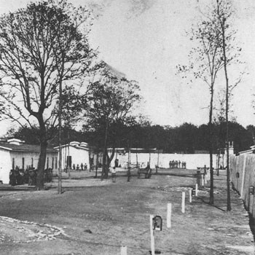
Deadlines
Literature review Feb. 21
HW3 due Feb. 28
Department of the Army/Rock Island Arsenal Museum

Slide 3
Themes of this class
The cost and reward of fairness
When are domain adaptation methods needed?
When is data “in domain” versus “out domain”
Domain adaptation methods
CyCADA (last class)
ADDA
Multi-task learning
Limitations to domain adaptation
When is a domain too different?
What to do if it is?

Slide 4
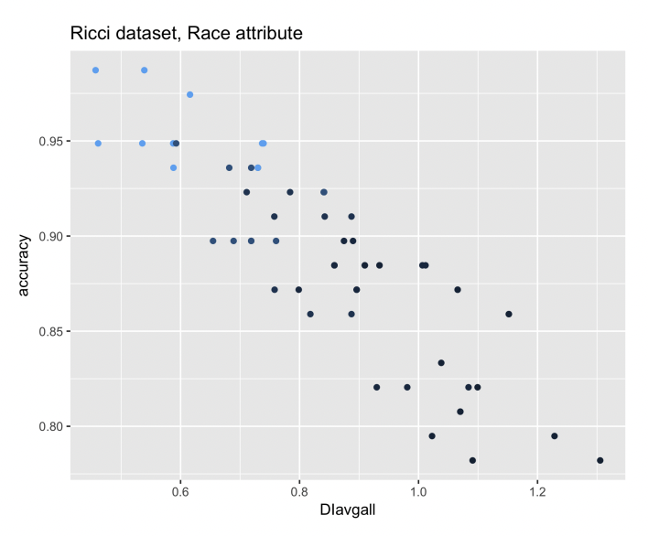
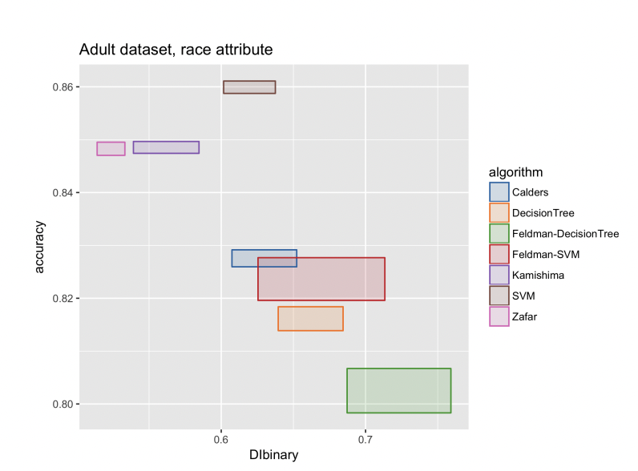
The Fairness Tradeoff
Fairness reduces accuracy, assuming fairness metrics
E.g., improving statistical parity reduces accuracy
Intuition: any constraint on a model outside of accuracy maximization reduces model effectiveness
One algorithm:
more accurate, less fair
No algorithm is both
Accurate & fair

Slide 5
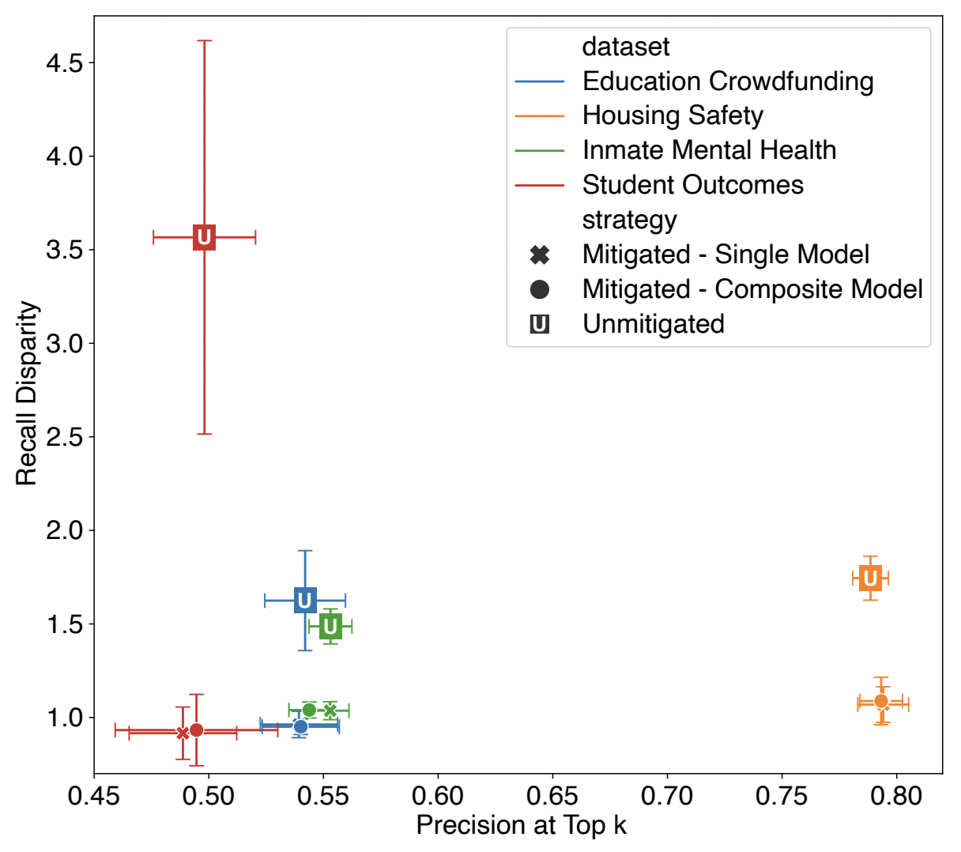
Empirical tradeoff
Sometimes tradeoff is minimal
Recall disparity: difference in recall between protected groups
Precision at top k: precision that ground truth in top k predictions
Plot shows reduction in recall disparity, no appreciable reduction in top k precision
Rodolfa et al., 2021

Slide 6
Fairness bargains?
Why do some data show a trade-off while others do not?
When is there a trade-off in data and when can models be both fairer and more accurate?

Slide 7
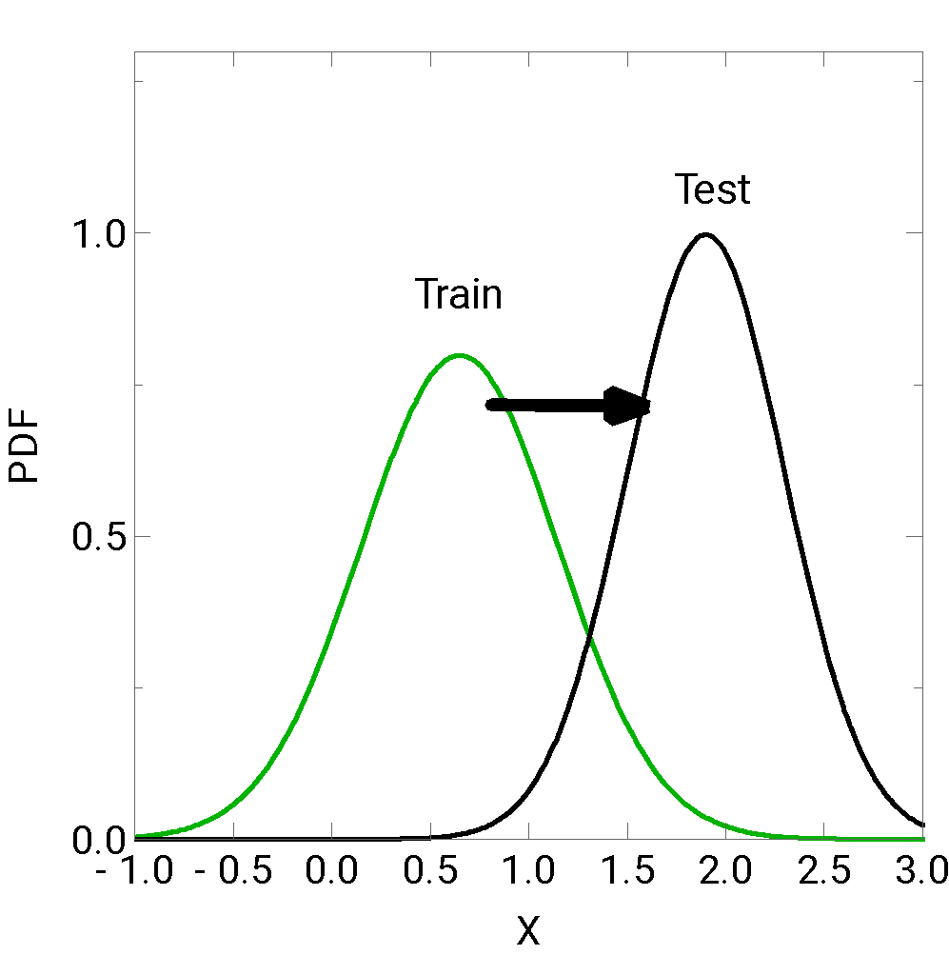
This is why data/covariate shift is important!
Fairness-bias tradeoff theorems implicitly assumes training/test data are similar
No impact from covariate/data shift
Model can be unfair if
Data is unfair (e.g., historical biases)
Demographics show covariate shift
Even with representative data, model may not work well for demographics with unique patterns
Data is not representative
Features differ, or
Covariates differ
between protected groups, more/less of some protected groups in test set
Men
Women

Slide 8
Caveats to domain adaptation fairness
It is hard to correct for historical biases
E.g., over-policing or over-arresting African Americans
Red-lining: using features correlated with protected groups to harm these groups
In these cases, domain shift will not necessarily change fairness
Historical biases therefore reinforce a fairness-bias trade-off
If domain adaptation is not a significant factor, theoretical assumptions better match data
Anonymity and fairness tradeoff (e.g., a fairer Facebook algorithm might run into issues if it requires detailed demographic information user’s do not want to share)

Slide 9
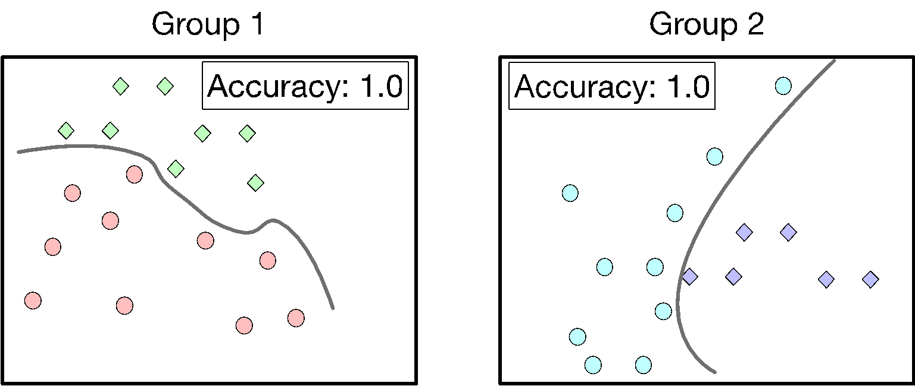
Case Study

Slide 10
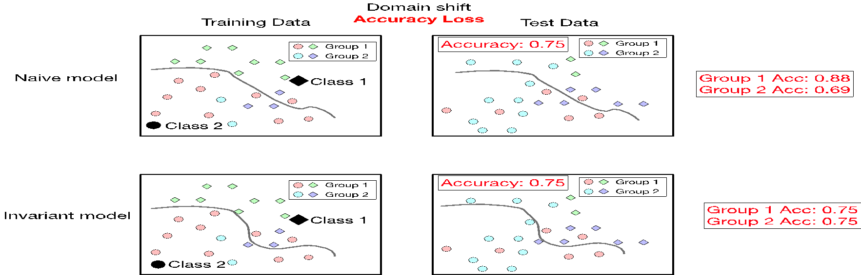
Optimal accuracy
Representative data
Good model may show disparities for different groups
Domain shift (fewer of Group 2 in training) demonstrates accuracy loss

Slide 11
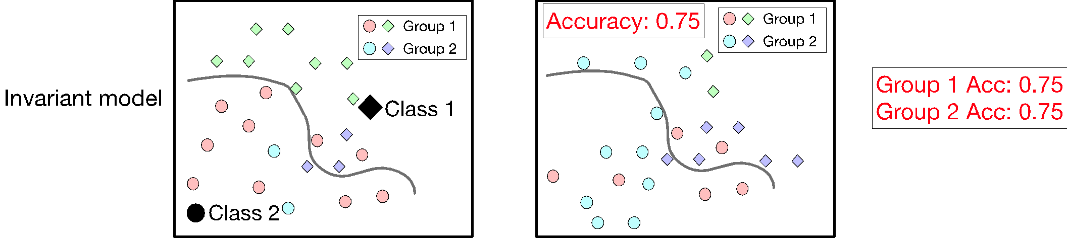
Optimal fairness
Representative data
Fair model: accuracy similar across groups (one metric of fairness)
Fairer model does not need to be less accurate
But may ignore important features

Slide 12
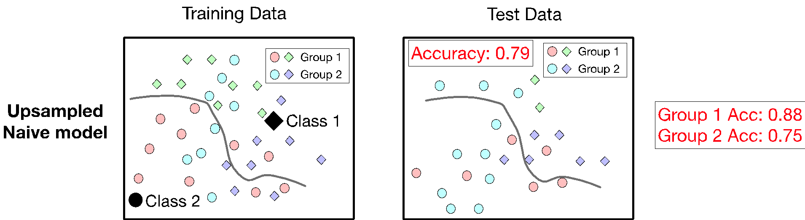
Upsampling (e.g., CyCADA, g-SMOTE)
Overall accuracy improves
Accuracy increases for each group
Gap in accuracy reduced
Not a panacea: we still see a gap

Slide 13
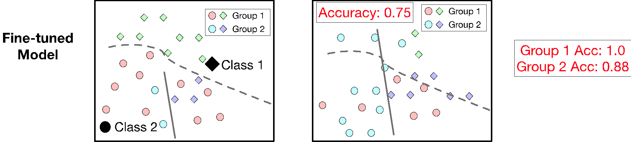
Fine-tuning to different demographics
First: predict demographic, then train model on these demographics
(similar to Choi et al., 2020; Burghardt et al., 2023)
Accuracy increases! Gap is reduced (still not as good as fair model)

Slide 14
Overall conclusions
Domain adaptation method examples
Upsampling
Fine-tune model
Improve data representation to make testing/training distributions similar
Domain adaptation can create more accurate and fairer models
No guarantee they are fairer! Not optimized to improve fairness
Fairer models show fairness/accuracy tradeoff (no need for this tradeoff if we address domain adaptation)

Slide 15
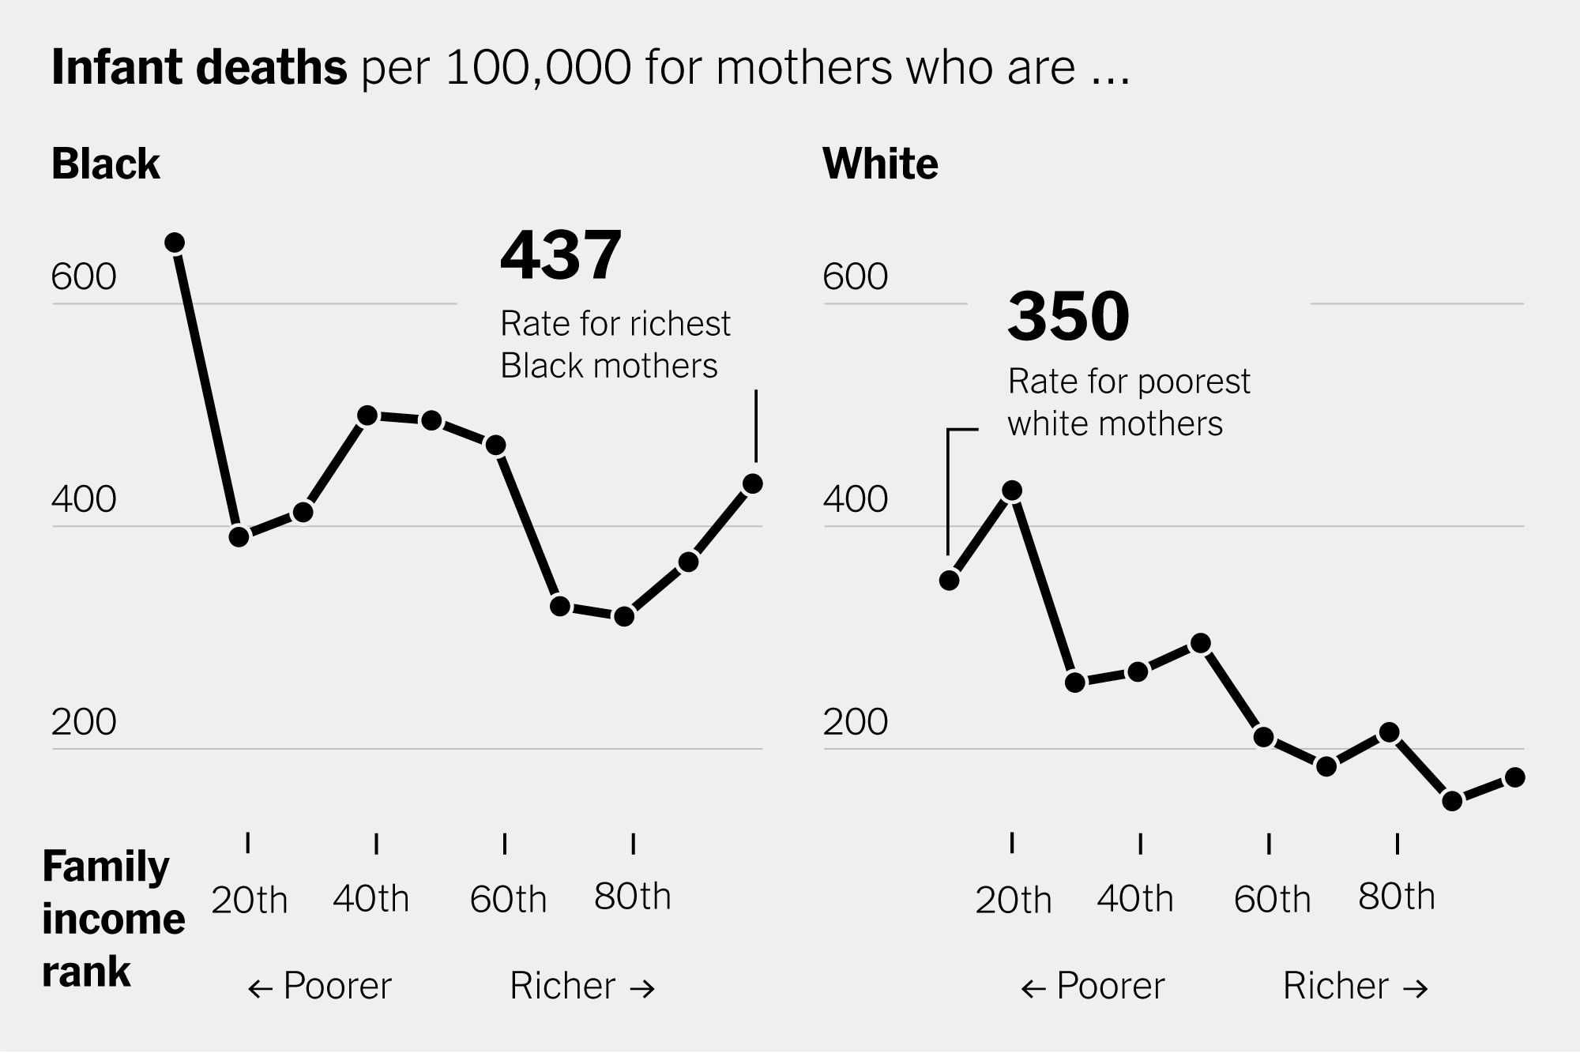
Universal versus demographic-specific characteristics
Issue in medical domain
Demographics may be important predictor
E.g., greater likelihood of infant mortality due to systematic racism
Invariant models could counter-intuitively
perform more poorly on some demographics
Another motivation for domain adaptation
NYT, 2023

Slide 16
Domain adaptation applications
Polygenic risk scores
ADDA
Multi-task learning

Slide 17
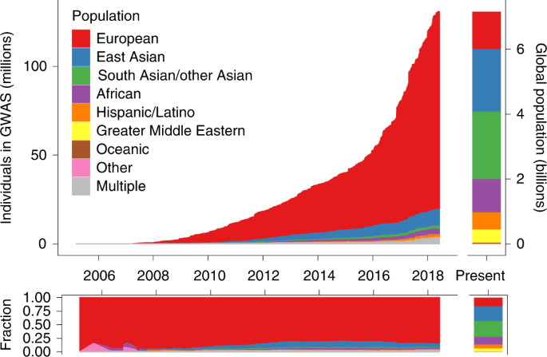
Polygenic risk scores

Slide 18
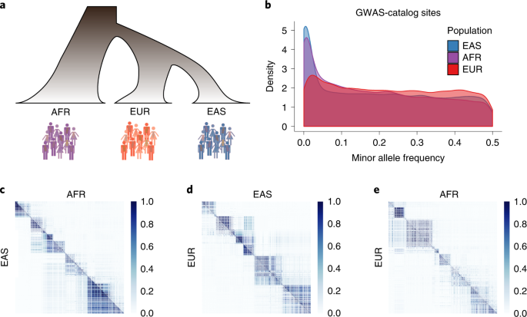
Feature shift

Slide 19
Feature shift

Slide 20
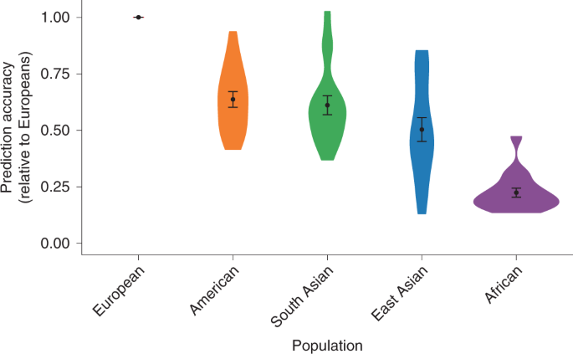
Less data on Africans + feature shift
= Less accurate predictions

Slide 21
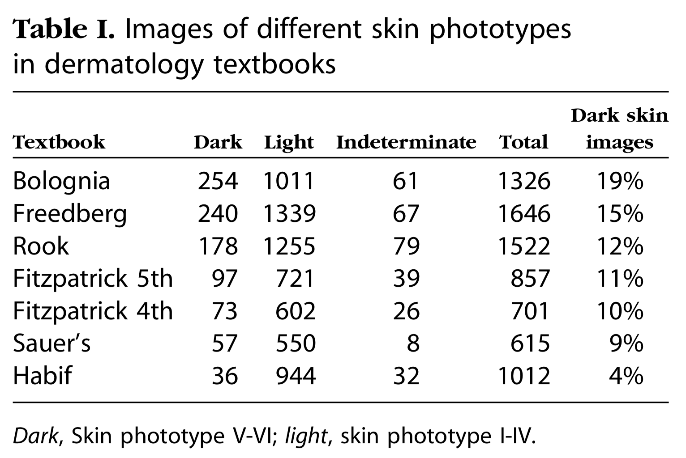
Group heterogeneity affects models
Ex: accuracy differs when detecting gender in whites and blacks
Models trained on images of Caucasians may work poorly on African-Americans
Accuracy may improve if distributions similar
Similar to batch normalization
Ex: detecting lesions on skin
Dermatologists and AI, trained on/work with many white patients
Might not not spot lesions in black patients
Rashes may look purple, or not readily apparent on non-white skin
Adamson and Smith, 2018
Gorbatenko-Roth et al., 2019

Slide 22
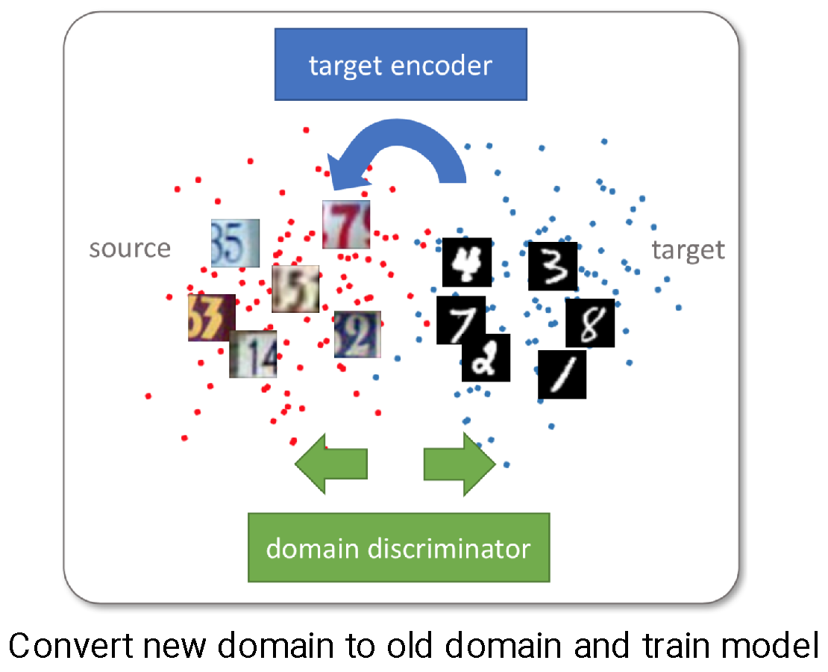
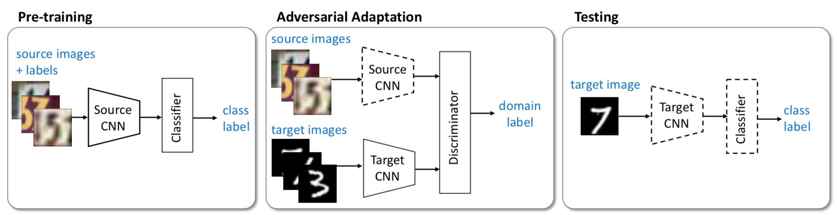
Adversarial Discriminative Domain Adaptation
Pre-training: train classifier on source data
Adversarial adaptation: force feature distributions to be similar
Testing: predict feature from target domain

Slide 23
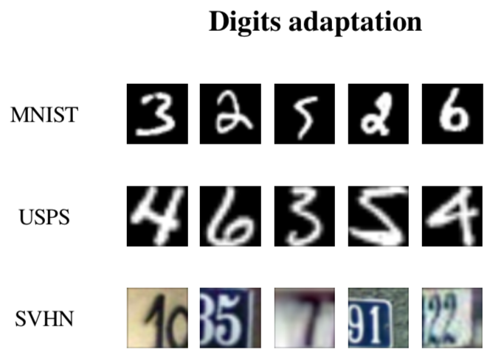
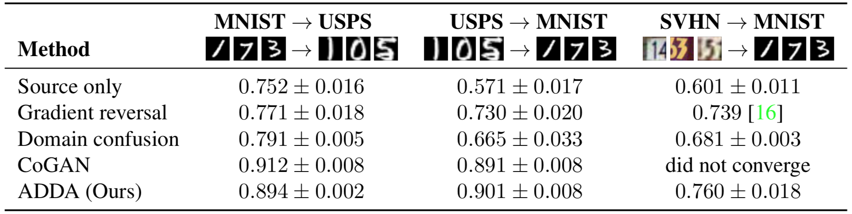

Slide 24
Applications to AI Fairness
If source data is dominated by a particular group
Adversarial approach makes feature distributions similar
Might improve fairness, but not its explicit design
Multi-task learning (next slide) or model invariance may be applied in tandem
Advantages of this method
Works for unknown/unlabeled protected groups
Reduces overfitting (model all protected groups at once)
Data agnostic (GANs work on a range of data)

Slide 25
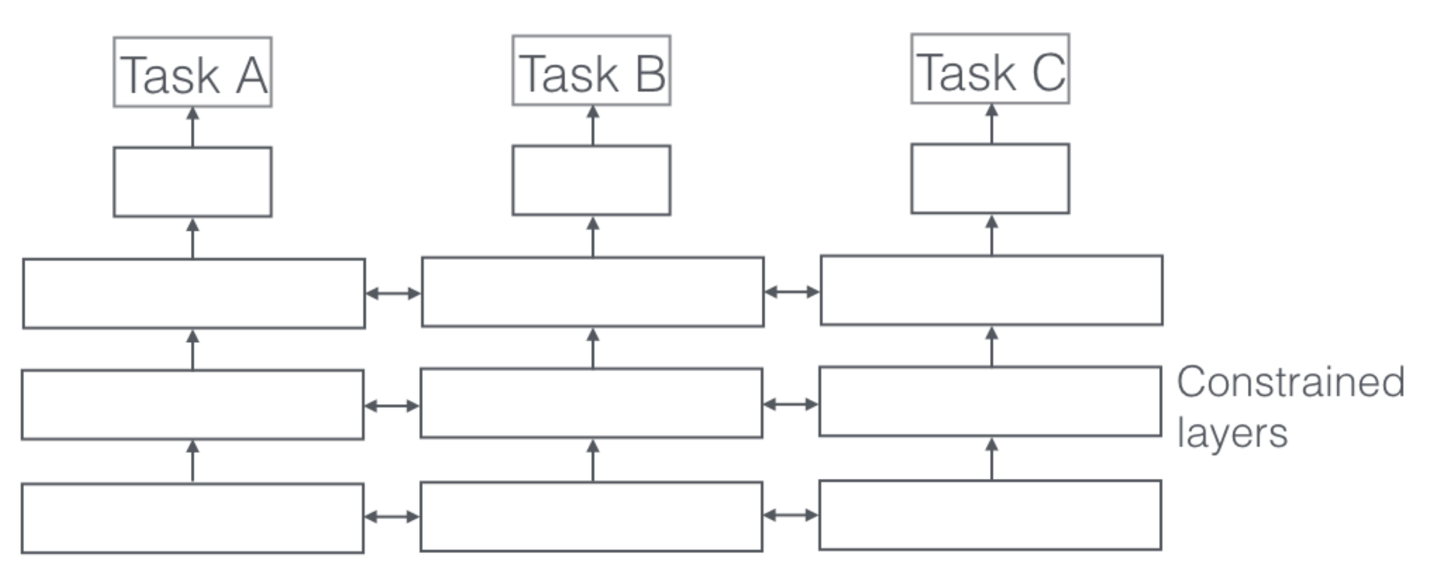
Multi-Task Learning
Apply multi-task learning to find both invariant and domain-specific features (Oneto et al., 2018)
Skin example mentioned previously demonstrates difficulties of domain-invariant models
Method assumes we know protected class labels
Advantage:
May work better for small protected groups
Aims to improve accuracy in all groups rather than overall accuracy

Slide 26
Some issues of domain adaptation
What subspace is domain adaptation needed most?
E.g., gray vs brown hair = domain, will not affect gender detection
Skin color *is* important
Could hand-label several features in data subset, audit each feature (Multiaccuracy-like approach)
Kicks can down the road: have we labeled all features? Is model fair or is auditing not separating features?
What to do when domains are very different?
First we should define domain distance

Slide 27
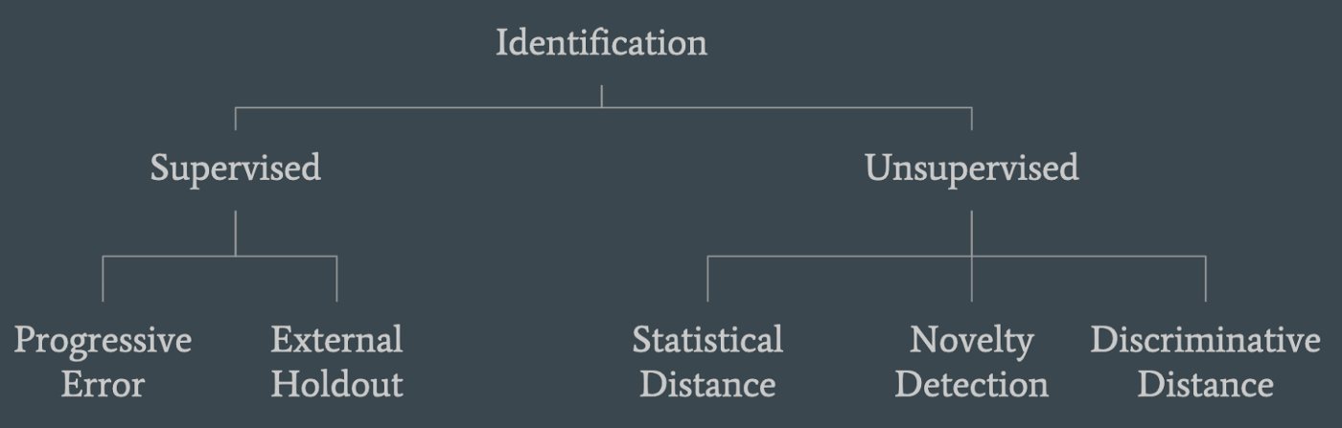
When does domain adaptation appear?

Slide 28
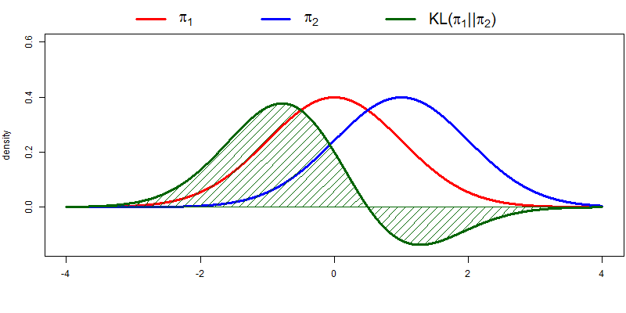
Unsupervised: statistical distance
Statistical distance: how different are the distributions?

Slide 29
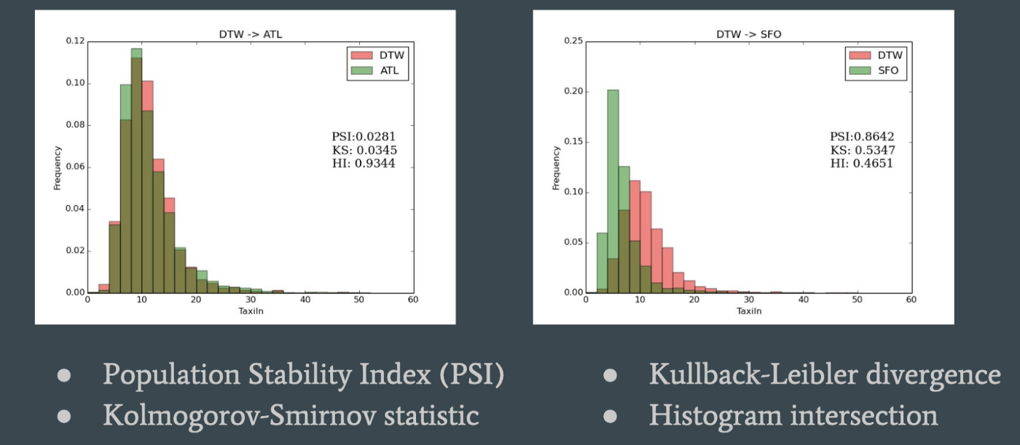
Alternative metrics (there are many)

Slide 30
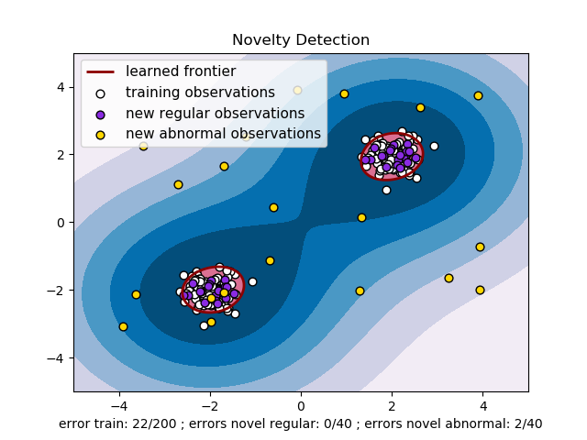
Unsupervised: novelty detection

Slide 31
Novelty detection
Examples: one-class support vector machine
Find outlier (what lies outside of training data)
Better method when data is high-dimensional and sparse
But outliers are not new domains (could be noise)

Slide 32
Unsupervised: Discriminative Distance
Train classifier to distinguish source, target domain
Target = test data
Discrimination error = how distinguishable these are (proxy of domain distance)

Slide 33
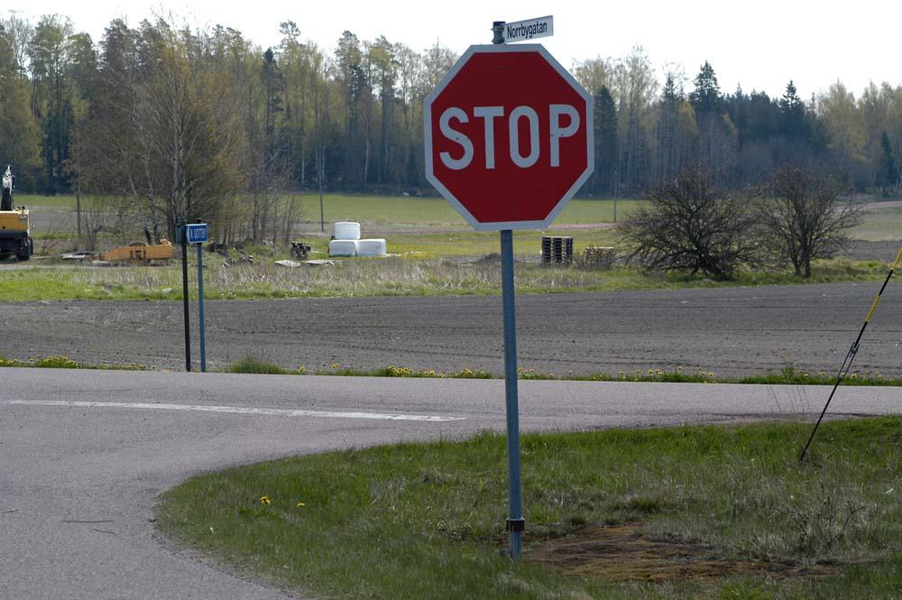
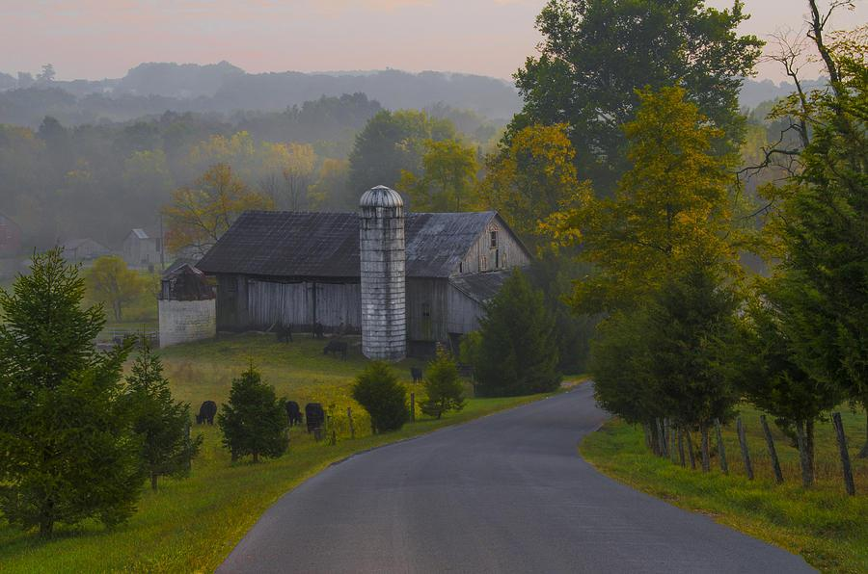
Discriminative Distance: (dis)advantages
Advantages:
Works well in high-dimensional, sparse data
If NN discriminator cannot distinguish, neither should any sophisticated model
Disadvantages:
Easy to distinguish ! = new domain! (e.g., photos with/without a stop sign)

Slide 34
Supervised: external holdout
Validation set: by definition same distribution as training data
Test/target set: unknown distribution/covariate shift
Error in validation set < target/test set = domain shift
Degree of error = how different are datasets
What if domain is very different?

Slide 35
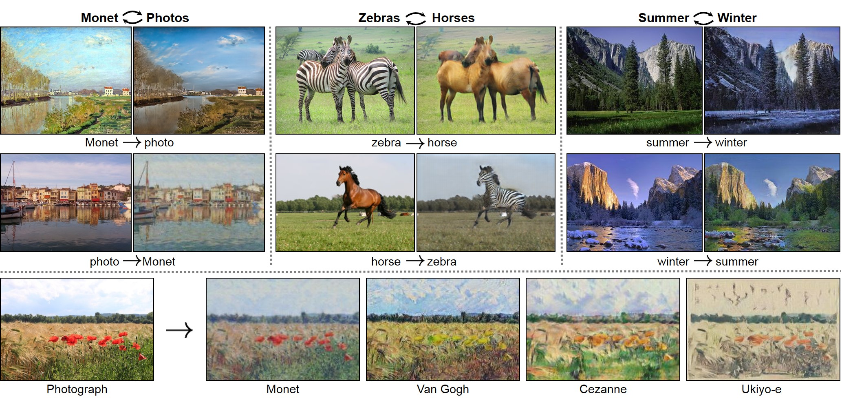
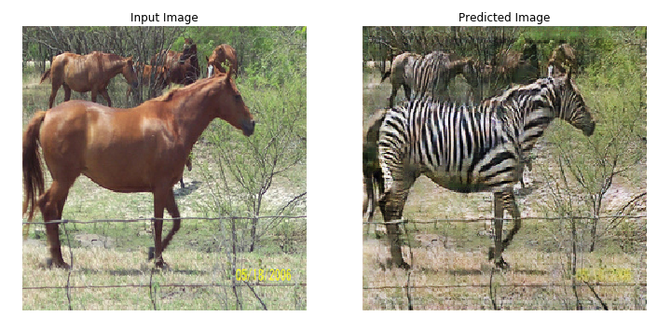
When is a domain too different?
CycleGAN

Slide 36
When is a domain too different?
Images of horses and zebras:
Same domain?
No!
Similar domain?
Yes!
How to generalize this finding?
We see “style changes” imply similar, distinct, domains…

Slide 37
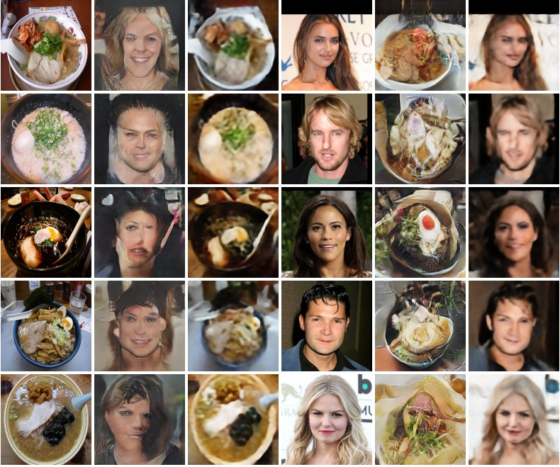
Determining if domains are too different
If changes perform well, when do they break down?
Example: face to ramen
(and other Lovecraftian horrors)
We can use CycleGAN as a self-supervised domain metric

Slide 38
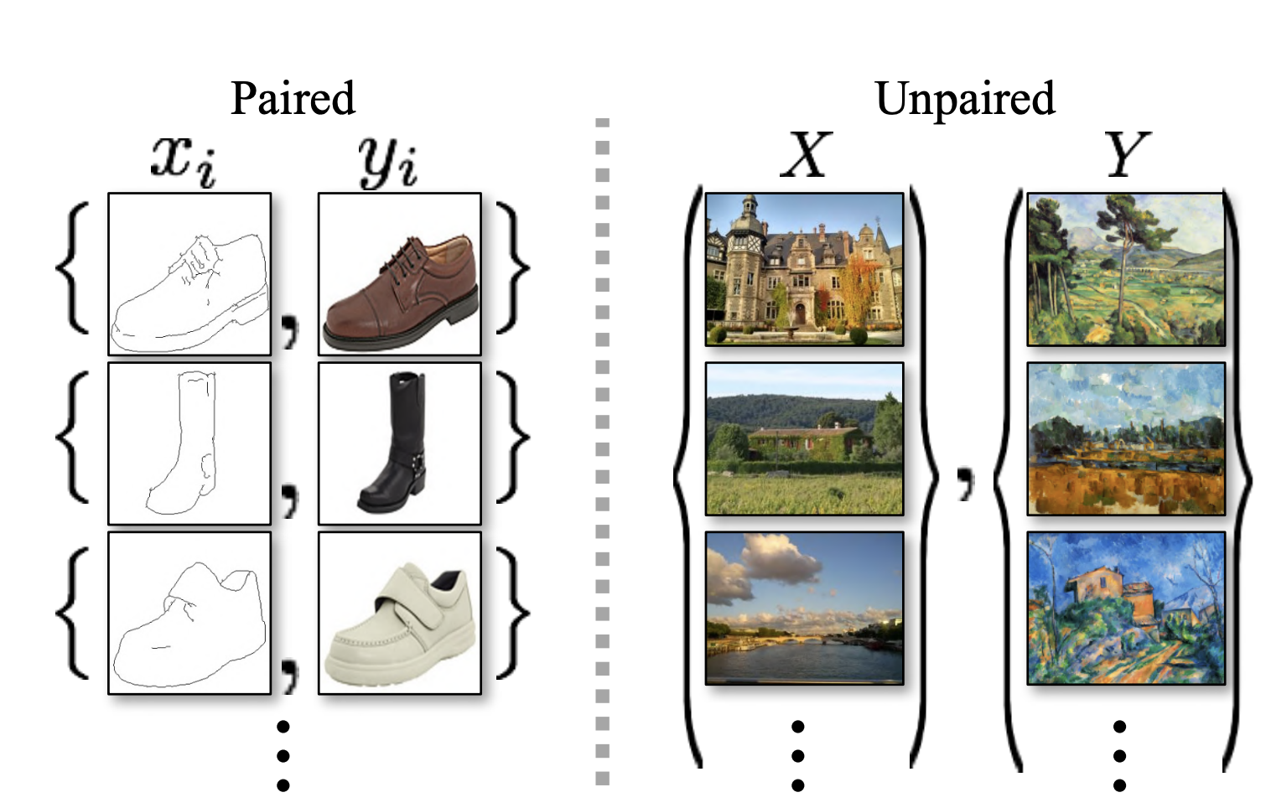
CycleGAN as an image domain tester

Slide 39
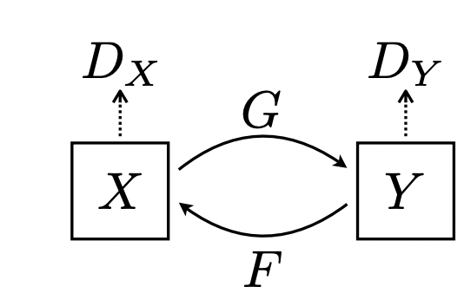
Convert image to new style and back again…

Slide 40
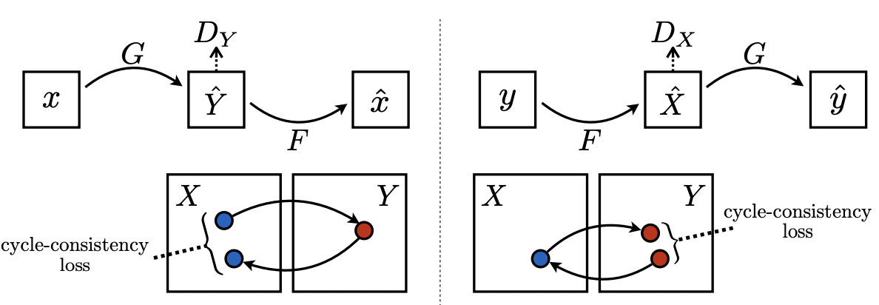
Self-consistency loss ensures no mode collapse

Slide 41
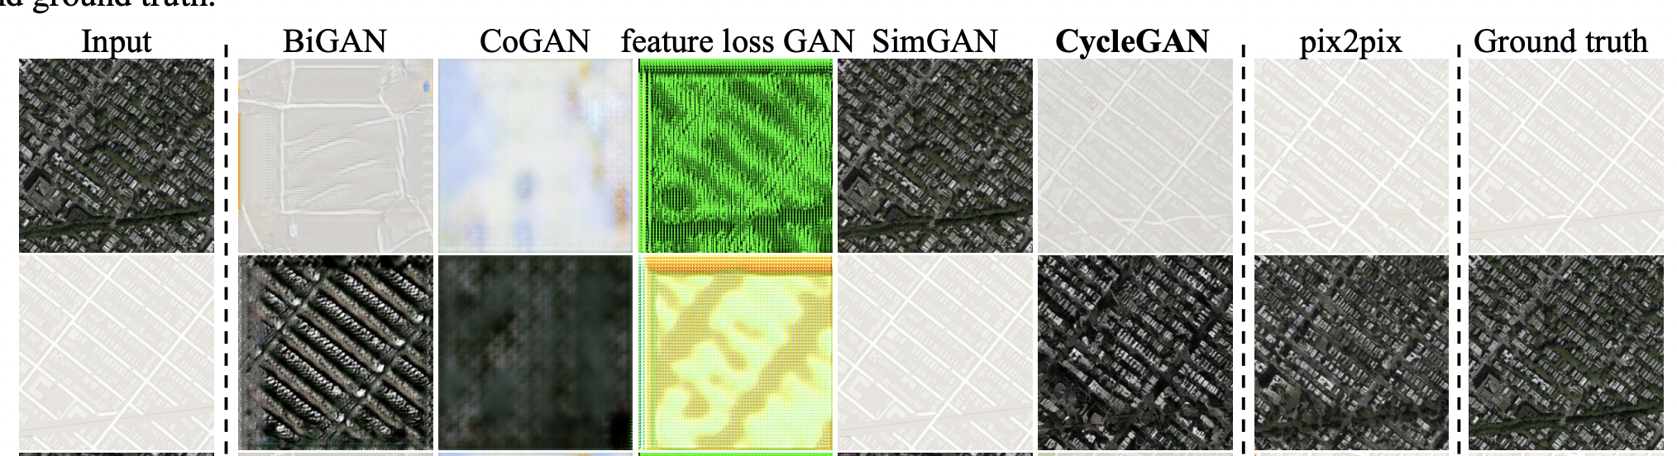
Competing methods (mode collapse)

Slide 42
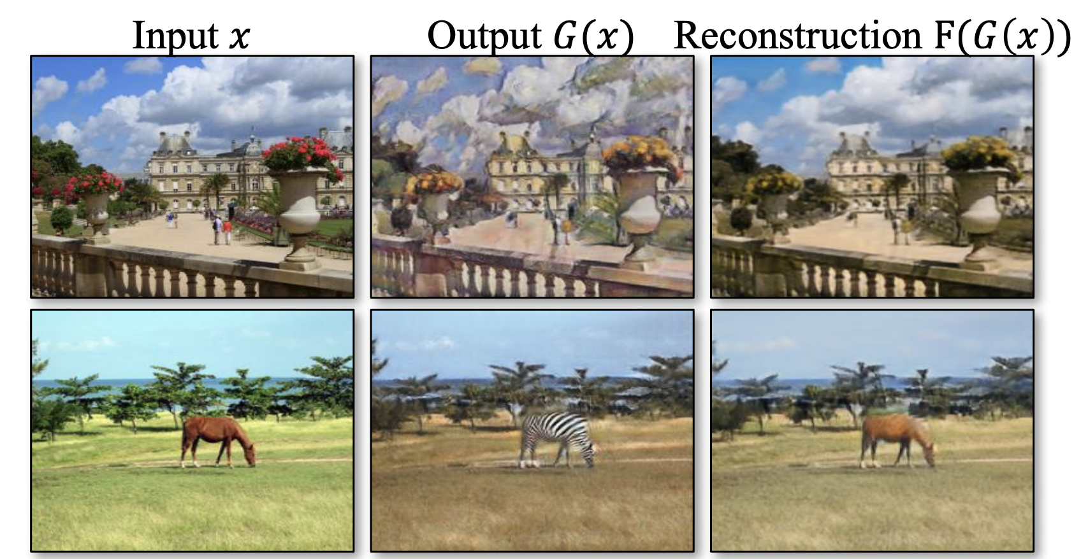
When CycleGAN works…
…If features of new style give CycleGAN enough information to reconstruct original image

Slide 43
If domain is too different (e.g., Ramen noodles)
Ramen noodles have no “face” (cannot reconstruct image well)
Quantitatively: if cycle-consistency loss is “too high” (threshold) domains are too different
Otherwise, DA might work

Slide 44
Assume domains are too different (breaks down) what do we do?
Examples:
Predicting if Ramen is spoiled when model is trained on detecting age of human faces
Predicting building built year in African buildings vs Spain
Buildings may be too different for many features to map well
Applying model trained on English data to French (languages are too different)
Start from beginning (what basic information can source domain give us) and move forwards

Slide 45
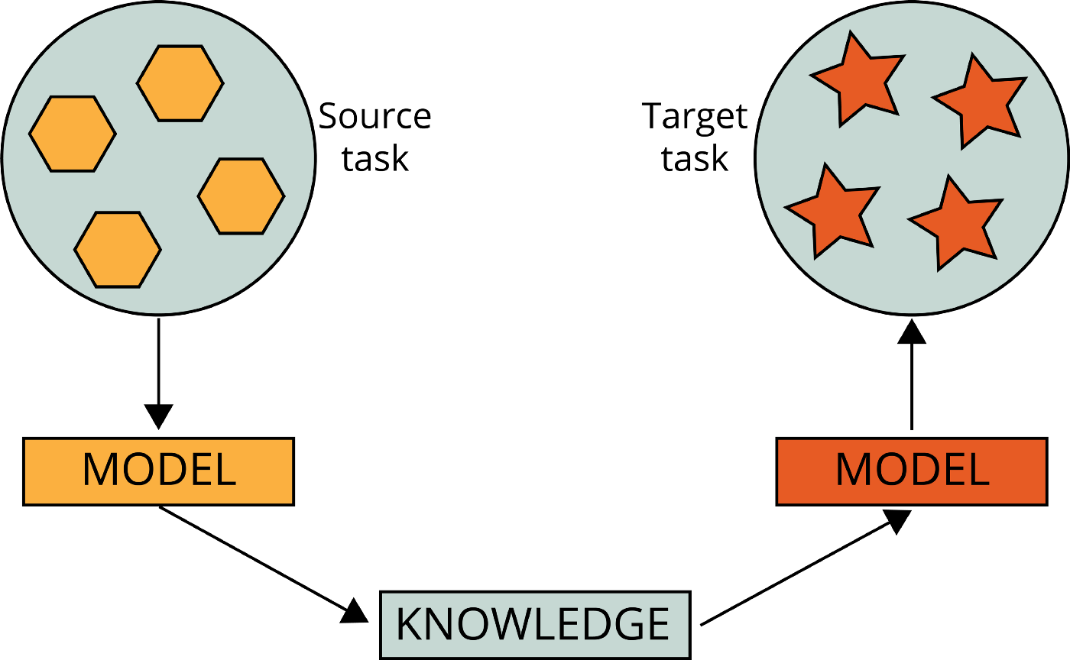
Different domains can still help!
https://towardsdatascience.com/4-pre-trained-cnn-models-to-use-for-computer-vision-with-transfer-learning-885cb1b2dfc

Slide 46
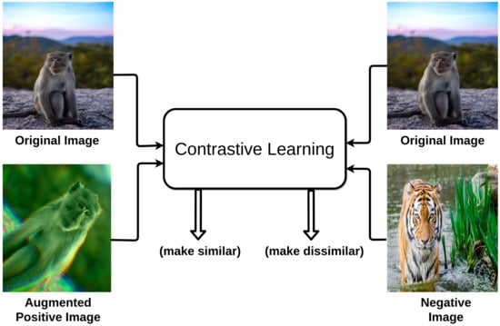
Example: pre-training
Self-supervised learning helps distinguish images
Distinguishing = learn colors, shapes, etc.
These universal features applicable to wide range of data

Slide 47
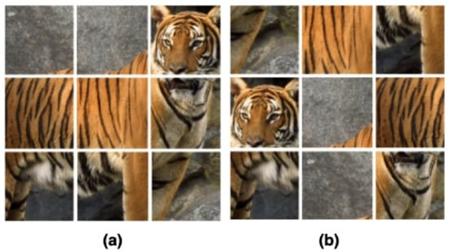
Pre-text tasks

Slide 48
Examples of pre-text tasks in NLP
Word embeddings (e.g., predicting words on either side of current word)
Sentence permutation
Etc.

Slide 49
Why this is helpful
With a large enough source domain, we can learn basic features (e.g., object detection)
With semi-similar domain, more features may be relevant
Few-shot learning can tailor universal feature to specific task

Slide 50
Summary of what we discussed
Costs and rewards of fairness
When domain adaptation can help or hurt
Where domain adaptation is needed
Computer vision (e.g., Gender Shades)
Other applications (e.g., polygenic risk scores)
Types of domain adaptation
ADDA
Multi-task learning
Measuring domain distance
What to do when domains are too different

Slide 51
Future work
We give an outline, but do not fully flesh out:
Distinguishing domains
Applying domain adaptation to model fairness
Finding domains we can easily adapt to
Domains are helpful, but no concrete work testing how it stacks up to fairness models

